Slide 1

Proof Of Concept
SproutBot

Slide 2
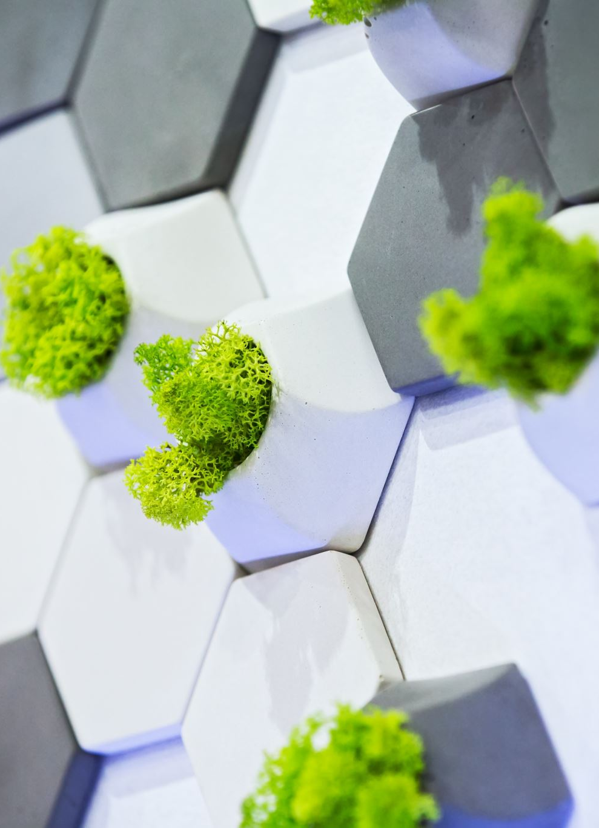
Essential Parts to Our Project
Plant Watering
Autonomous Navigation

Slide 3
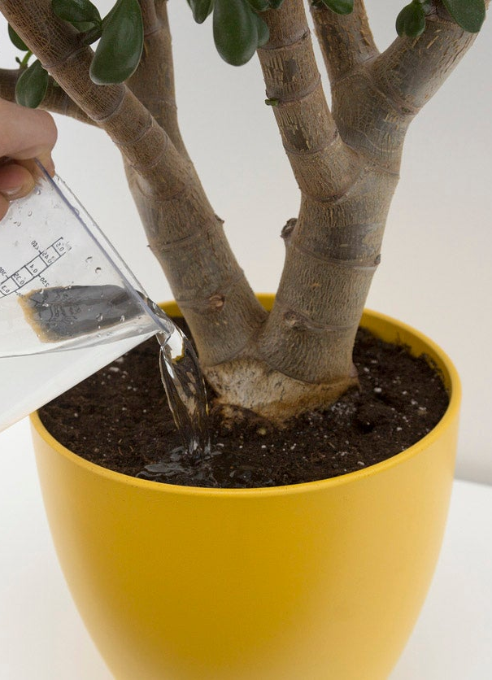
Plant Watering – Soil Obstruction
Water delivery to the plants soil is essential to the project
A potential issue exists that the robot believes it is over the soil when in fact it is not
Accurate navigation (discussed later) will be used to drive the robot to the plant in the correct orientation, however it cannot deal with the soil being blocked by foliage

Slide 4
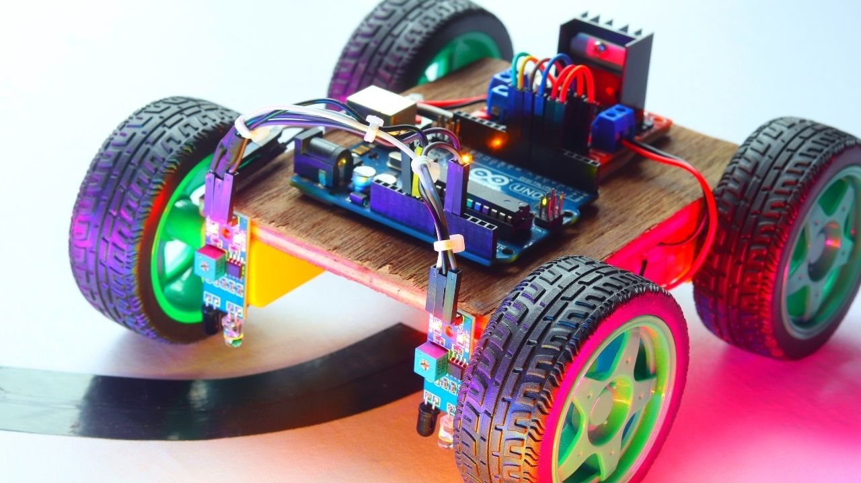
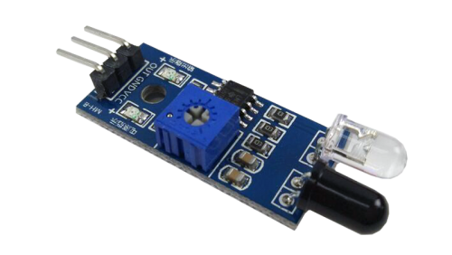
Soil Obstruction Solution
The proposed solution for detecting the soil is infrared (IR) sensors to detect the contrast between foliage and dirt
Once the robot arrives at the plant, an arm will extend out and hover over the plant
The IR sensor will determine if the nozzle is over foliage (light) or dirt (dark)
Plant dirt is assumed to be within in a specific height range

Slide 5
Localization & Obstacle Detection
Successful navigation to the different plants and home base without running into obstacles or getting lost are essential to this project.
Two potential issues exist including:
The robot does not know its location relative to its home base and the different plants.
The robot cannot detect obstacles and move around them, which causes collisions and harm to the robot, the surrounding environment and the plant.

Slide 6
Autonomous Navigation
Need to navigate without user input
Some parts to be used:
Arduino (For robot control and Plant identification)
PC (For data processing) [ Raspberry Pi / Old Laptop ]
Ultrasonic Sensors (For Obstacle Detection)
IR Emitter & Sensor (For precise plant location)
Wheels with encoders (For Odometry)

Slide 7
Autonomous Navigation
Plant and Base will have IR emitters for robot to detect as necessary
Navigation techniques:
SLAM (Simultaneous Localization And Mapping)
UWB (Ultra Wide Band) Positioning
Path Planning with Wheel Odometry + IMU Sensor Fusion
Will likely combine multiple if time permits

Slide 8
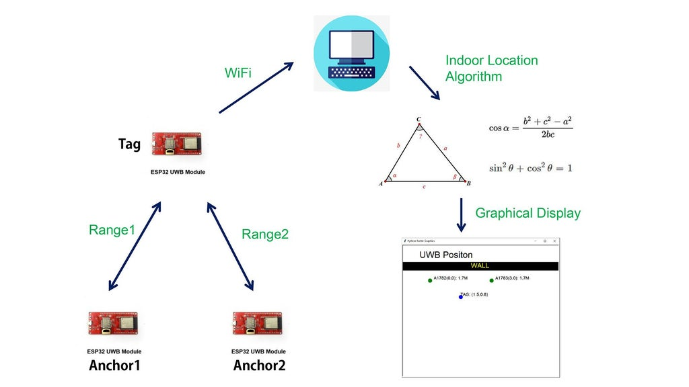
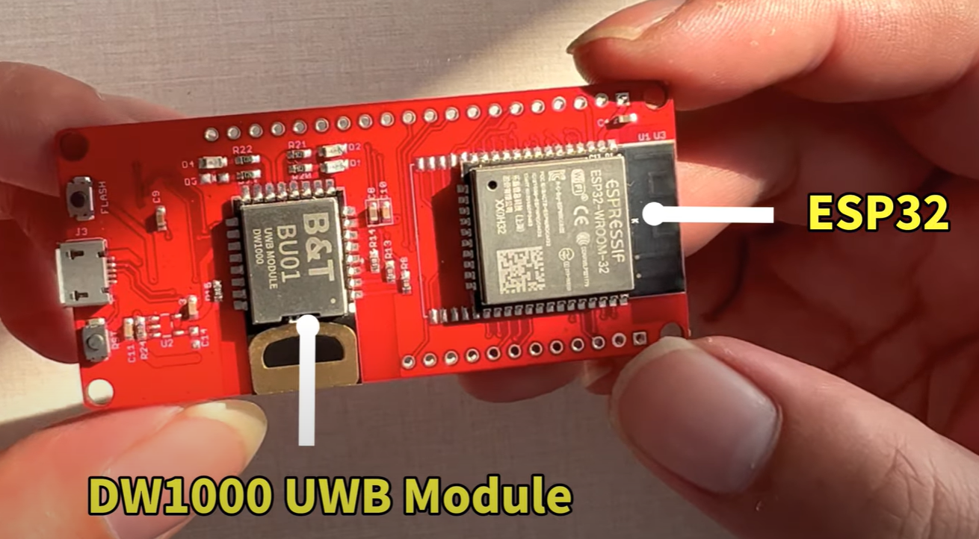
UWB Positioning
Minimum 2 anchor UWB boards needed to act as references
1 Receiver board is on robot
Localization happens relative to UWB anchors
https://www.instructables.com/ESP32-UWB-Indoor-Positioning-Test/
High costs for us ($60/board)

Slide 9
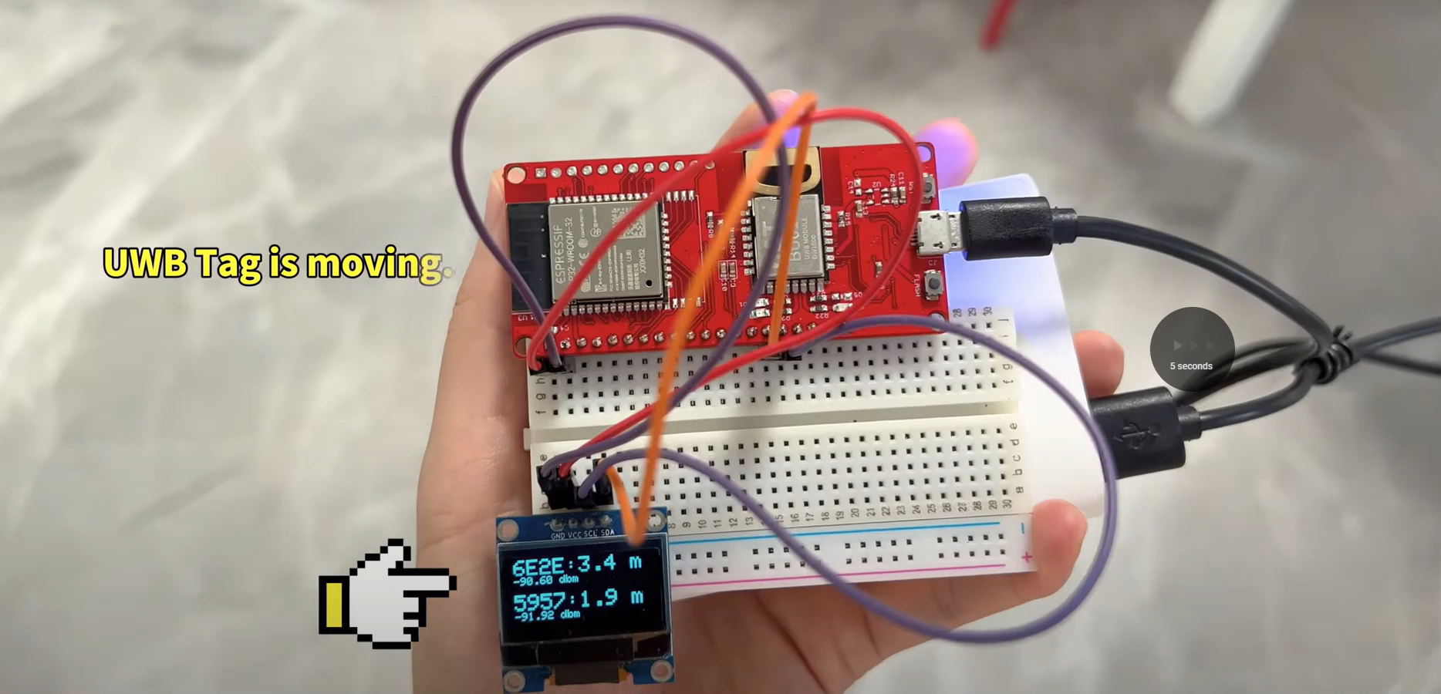
UWB Positioning

Slide 10
SLAM
Generate a map of the environment
Localize the robot and the plant in the map
Pros
Many open-source examples/resources available
Most precise and reliable option
Can detect and avoid obstacles in advance
Cons
Overkill for this project
Heavy processing required
Increased power consumption

Slide 11
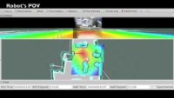
Chosen Solution: SLAM

Slide 12
Considered: Path Planning
Use wheel encoders to calculate movement distance and speed
Use IMU to confirm movement and orientation
Record data on initial trip done by user
Repeat actions on subsequent trips
Keep track of distances moved when avoiding obstacles, use trigonometry to get back on original path
If destination can’t be found, move until IR signal is found

